Slide 1
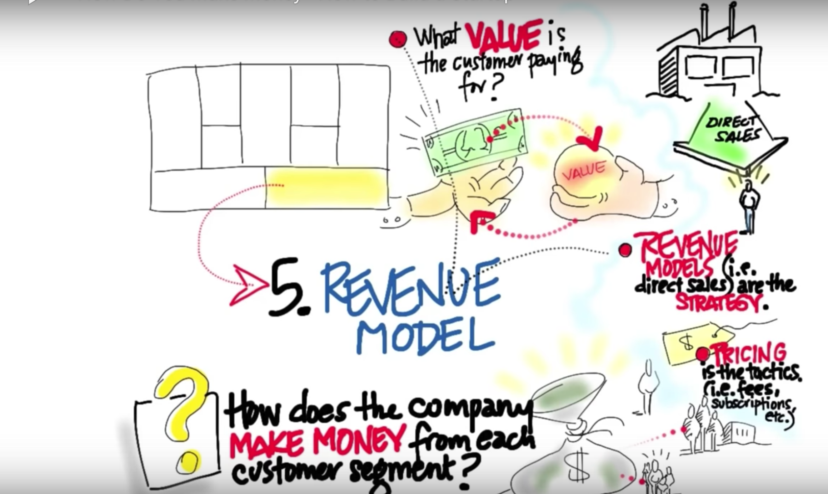
Wifi password:
smartyouth
Notes:
Remind students to connect to the WiFi

Slide 2
Overview
Introductions
Bmc presentations
Revenue models
Pitch Presentations

Slide 3
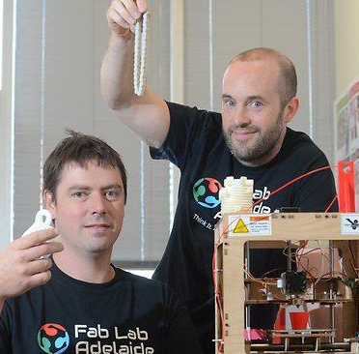
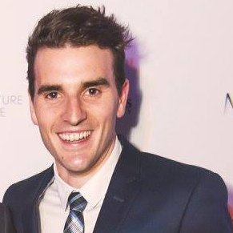
Wil tamblyn & gavin smith
Entrepreneurs in residence
Ben Tripodi
Introductions
Notes:
Conclude this activity at 1:15

Slide 4
Understanding the Business Model Canvas
Sign into kahoot using the link below:
Kahoot
https://kahoot.it/#/
Create a team for your school

Slide 5
Review the homework
Business Model
Canvas
Notes:
In groups, review the homework and clarify any misconceptions. Run from 1:40 - 2pm.

Slide 6
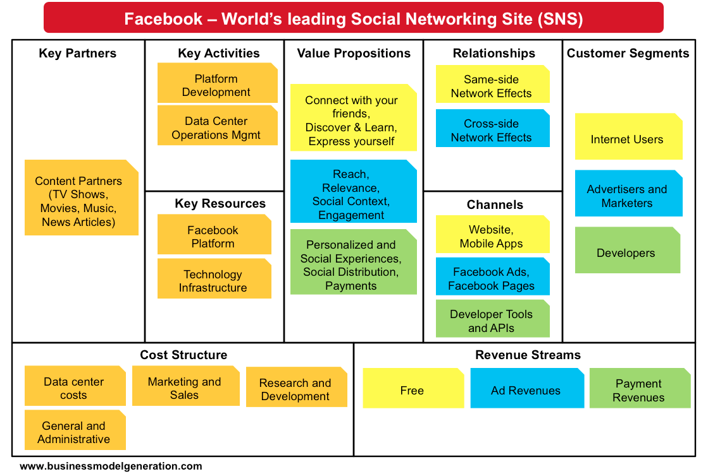
review your Canvas
Notes:
2:10 - 2:30 - Students will work in the "business teams" to complete the initial information on their BMC using the "Stormboard" online brainstorming tool
2:30 - We work with our teams to clarify their customer developent and value propositions. We need to support them to identify how they plan to speak to 10-15 customers about their problems and current solutions, how large their budget is and what they spend it on, and how this fits on their BMC.

Slide 7
Revenue Models
http://bit.ly/VenDRev
Notes:
This activity should run from 1:20 to 1:40

Slide 8
Bmc development
Revenue Streams
A1 - What Value are customers willing to pay for? (how do you know this?)
A2 - How do your customer segments pay for products today?
A3 - What capacity do they have to pay?
A4 - How much are they currently paying?
A5 - Draw your diagram http://bit.ly/VenDRev1
A6 - How will you “package your product”
A7 - How will you price the offerings?

Slide 9
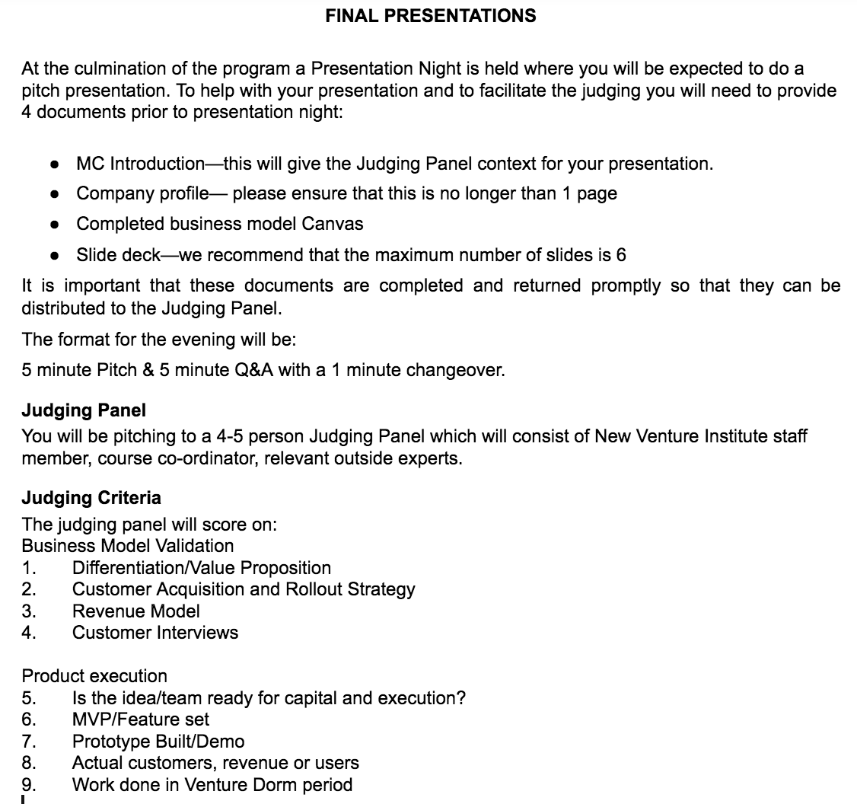
http://bit.ly/VenDormPitch16

Slide 10
Deliverables - this session
3 minute pitch detailing:
Value proposition
Customer segments
Customer relationships
Channels
Revenue streams
2. Stormboard business model canvas.

Slide 11
Homework for next week
Review this week’s materials at: Partners
And prepare for the Entry Assessment next week
Deliverable for next week: Execute your Customer Research plan
Refine your marketing campaign, refine your website &/or prototype.
Peruse videos on Partners. Speak with 10-15 customers about your revenue model. Identify potential partners
Update BMC & Complete your journal reflections on learning

