Slide 1
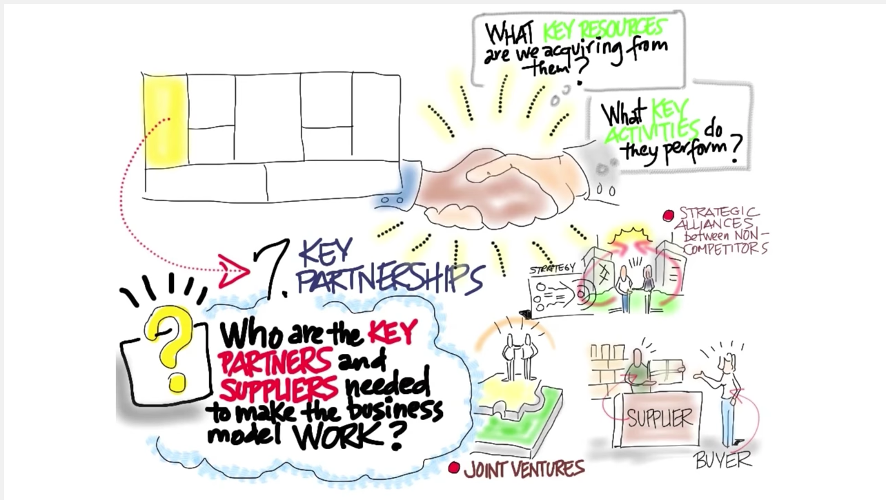
Wifi password:
smartyouth
Notes:
Remind students to connect to the WiFi

Slide 2
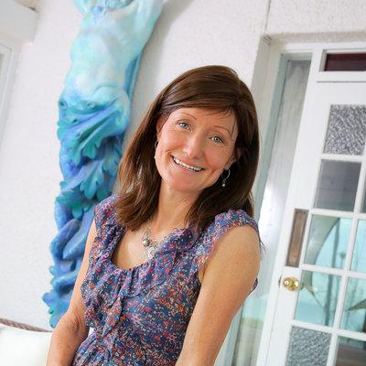
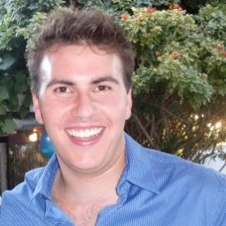
Entrepreneurs in residence
Sarah gun
Alex Tripodi
Founder & Director of GoGo Events
Recipient most Innovative Social Enterprise Award @ SXSW Innovation Conference in Texas
Board Member of the Hutt Street Centre
Managing Director Day Dreamer Australia
CEO TRVL Mobile
Co-Founder Man Candle
Finalist in the 2014 Hahn Jumpstart Entrepreneurial Challenge
Notes:
Conclude this activity at 1:15

Slide 3
Overview
Introductions
Bmc presentations
Revenue models
Pitch Presentations

Slide 4
Review the homework
Business Model
Canvas
Notes:
In groups, review the homework and clarify any misconceptions. Run from 1:40 - 2pm.

Slide 5
Bmc development
Revenue Streams
A1 - What Value are customers willing to pay for? (how do you know this?)
A2 - How do your customer segments pay for products today?
A3 - What capacity do they have to pay?
A4 - How much are they currently paying?
A5 - Draw your diagram http://bit.ly/VenDRev1
A6 - How will you “package your product”
A7 - How will you price the offerings?

Slide 6
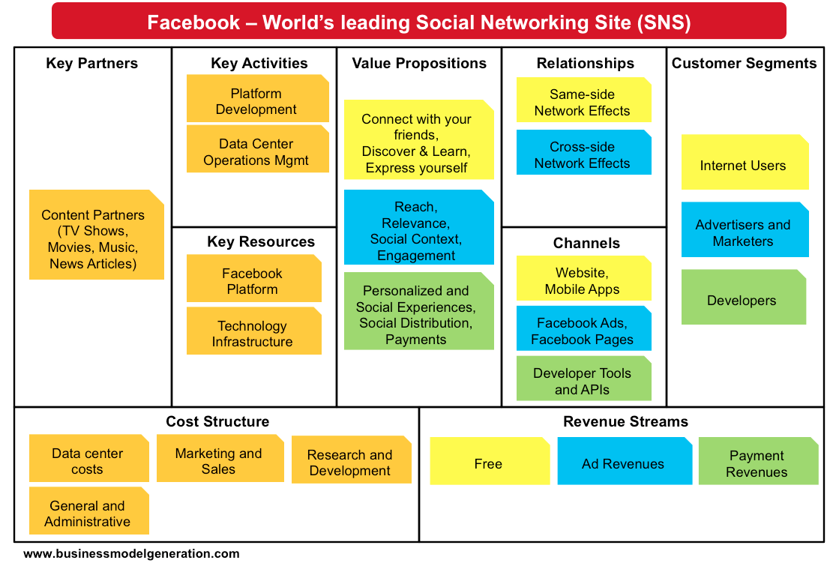
review your Canvas
Notes:
2:10 - 2:30 - Students will work in the "business teams" to complete the initial information on their BMC using the "Stormboard" online brainstorming tool
2:30 - We work with our teams to clarify their customer developent and value propositions. We need to support them to identify how they plan to speak to 10-15 customers about their problems and current solutions, how large their budget is and what they spend it on, and how this fits on their BMC.

Slide 7
partners
http://bit.ly/VenDPartners
Notes:
This activity should run from 1:20 to 1:40

Slide 8
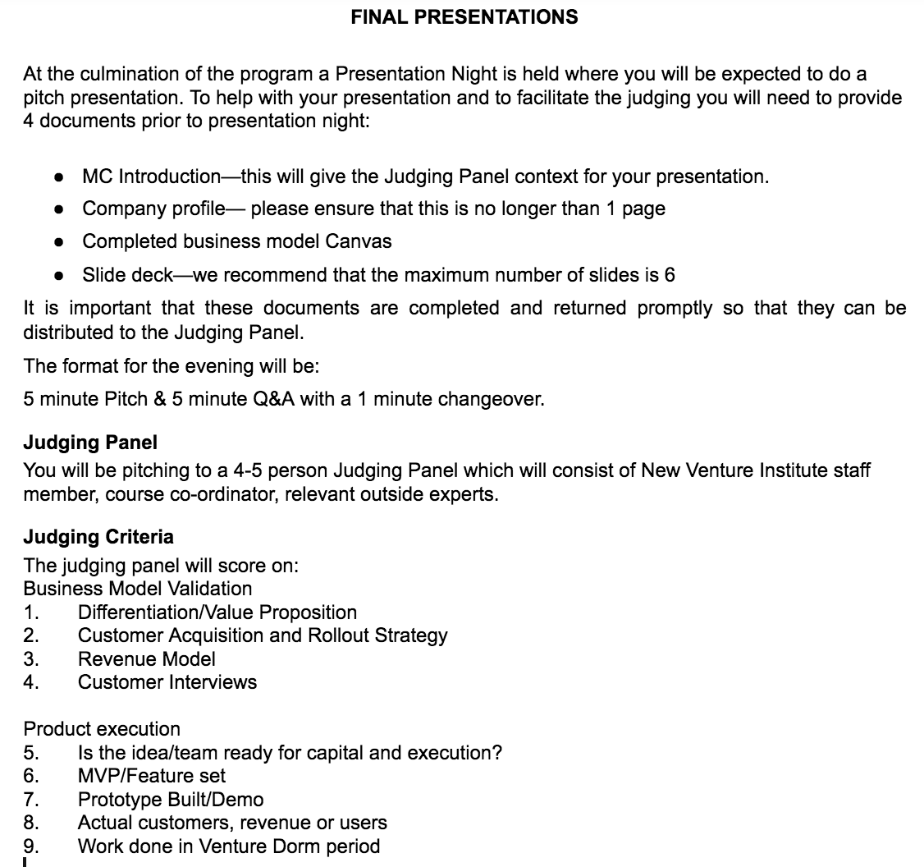
http://bit.ly/VenDormPitch16

Slide 9
Deliverables - this session
3 minute pitch detailing:
Value proposition
Customer segments
Customer relationships
Channels
Revenue streams
partners
2. Stormboard business model canvas.

Slide 10
Homework for next week
Review this week’s materials at: Resources, Activities & Costs
And prepare for the Entry Assessment next week
Deliverable for next week: Speak with 10-15 partners. Prepare for presentation, talk with your mentor, update your journal and Business Model Canvas.
Prepare your marketing campaign, website &/or prototype for presentation next week
Identify your Expenses and refine your revenue model (Look back at the Revenue model presentation if required).
Update BMC & Complete your journal reflections on learning

