Slide 1
http://bit.ly/VenD8
Wifi password: smartyouth
Notes:
Remind students to connect to the WiFi

Slide 2
Entrepreneurs in residence
Adele flego
Wendy perry
Founder and Principal of Chiliad Consulting Intellectual Property Services.
Registered Australian and New Zealand Patent and Trademark Attorney
Qualifications
Master of Business Administration,
Master of Industrial Property Law
Bachelor of Biotechnology (Honours).
Managing Director: Wendy Perry and Associates Pty Ltd
VET Strategist at WPAA
Head Workforce Planner at Workforce BluePrint
Notes:
Conclude this activity at 1:15

Slide 3
Overview
Introductions
Pitch night deliverables
Bmc presentations
Develop action plans
Who
What
when

Slide 4
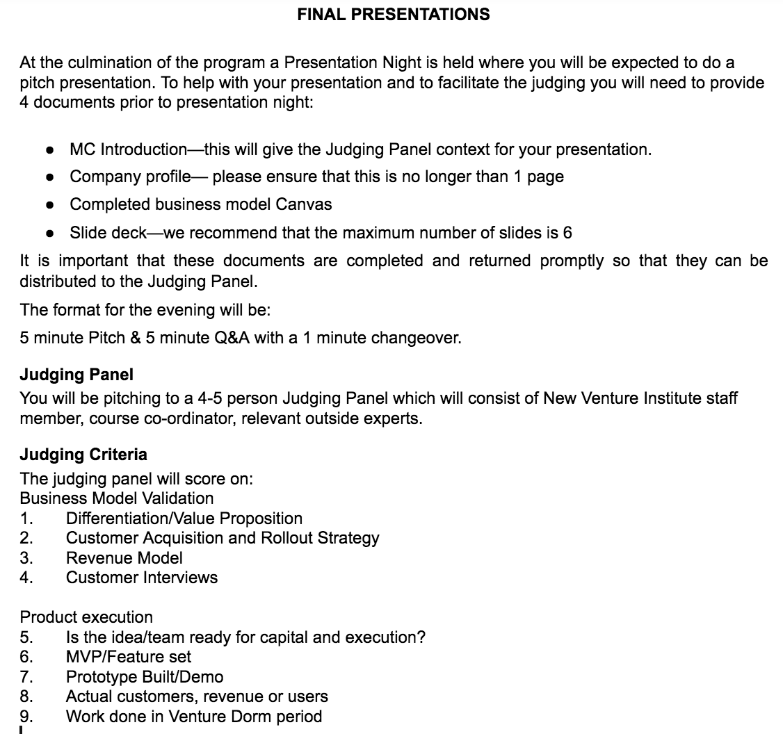
http://bit.ly/VenDormPitch16

Slide 5
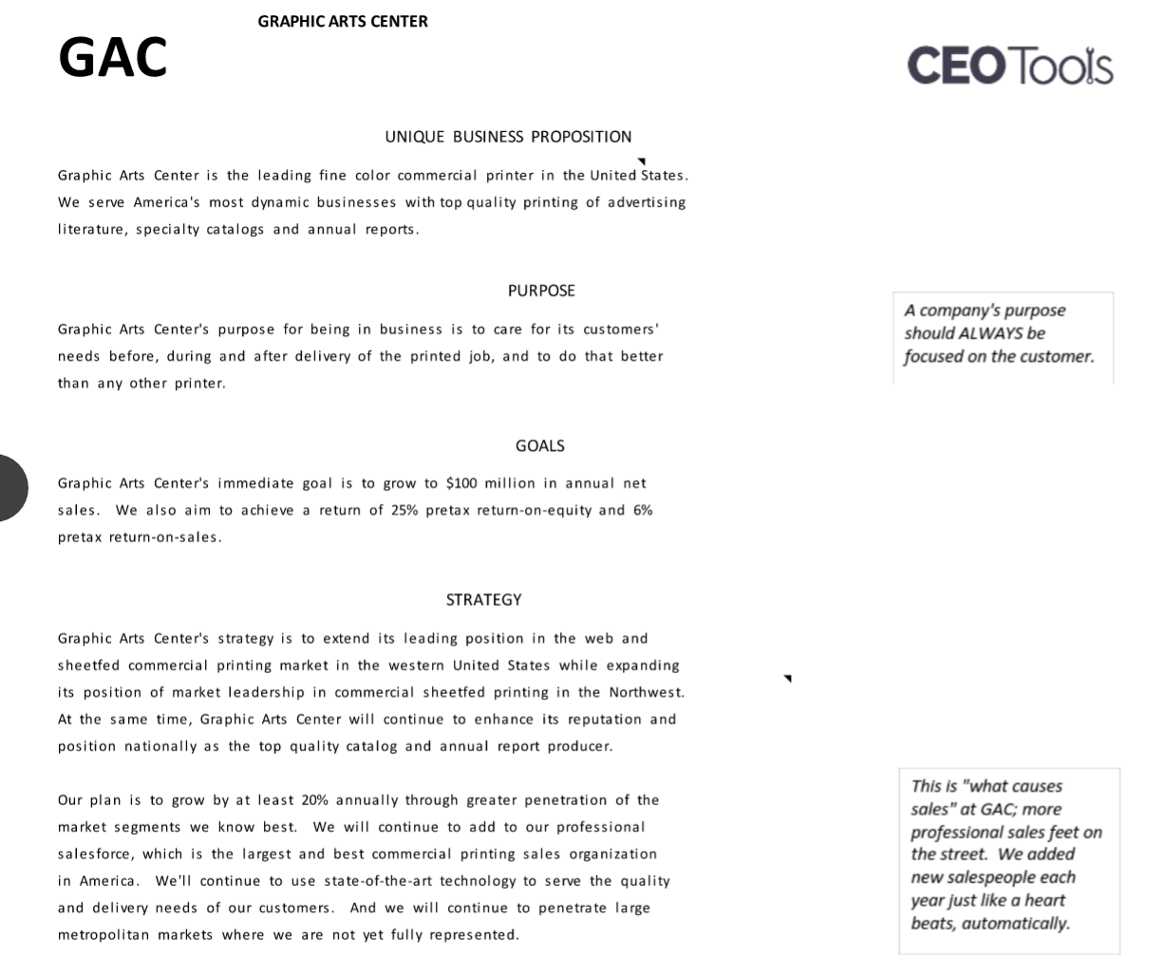
Company profile
http://bit.ly/VenDCProfile

Slide 6
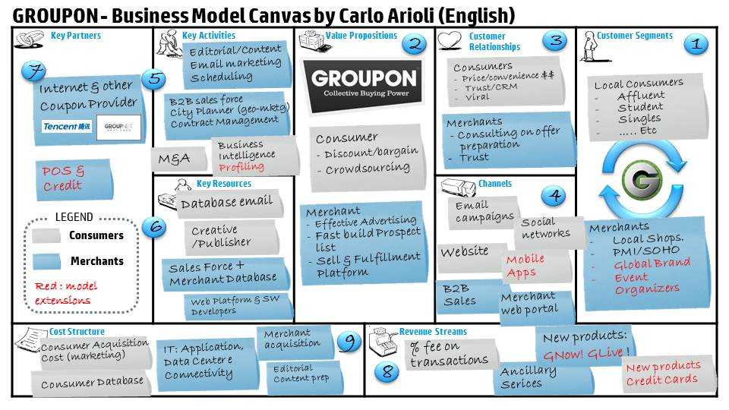
Completed business model Canvas - see rob for login
Notes:
2:10 - 2:30 - Students will work in the "business teams" to complete the initial information on their BMC using the "Stormboard" online brainstorming tool
2:30 - We work with our teams to clarify their customer developent and value propositions. We need to support them to identify how they plan to speak to 10-15 customers about their problems and current solutions, how large their budget is and what they spend it on, and how this fits on their BMC.

Slide 7
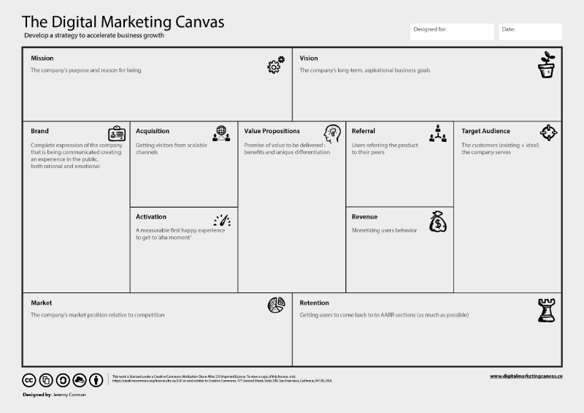
Marketing plan
http://bit.ly/VenDMarket
Notes:
2:10 - 2:30 - Students will work in the "business teams" to complete the initial information on their BMC using the "Stormboard" online brainstorming tool
2:30 - We work with our teams to clarify their customer developent and value propositions. We need to support them to identify how they plan to speak to 10-15 customers about their problems and current solutions, how large their budget is and what they spend it on, and how this fits on their BMC.

Slide 8
Slide deck and supporting resources
Slide deck
Prototype
Key findings from customer development
Website
Marketing plan

Slide 9
Bmc presentations
Introductions
value proposition (MVP), customer segments, relationships, channels & revenue streams
Partners
Type (Strategic, joint business dev, coopetition, key suppliers)
Partner risks
Resources
4 resources (physical, financial, human, intellectual)
Activities
Key activities
Costs
Operating, customer relationships (incl. Burn rate), revenue streams, channel’s

Slide 10
Homework for next week
Prepare for the pitch workshop!!
Finalise your business model canvas
Complete your marketing plan
Complete your website
Complete your presentation prototype
Draft your slide deck
Prepare for the pitch workshop

